Slide 1
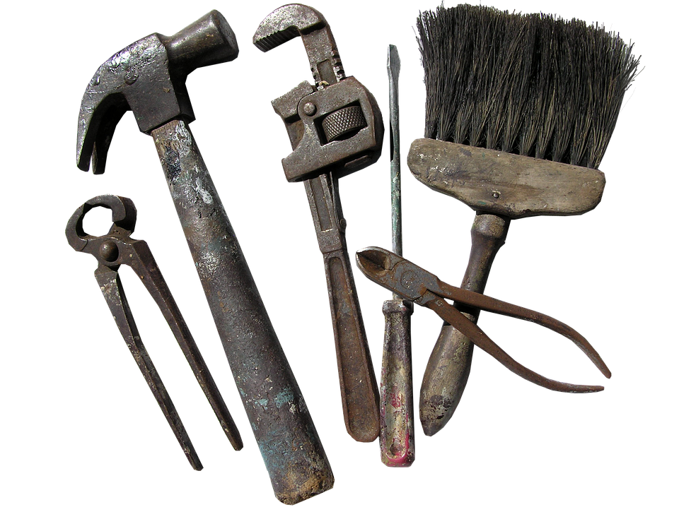
Adobe Connect Tools
Ideas on how to use them in
Classics Teaching

Slide 2
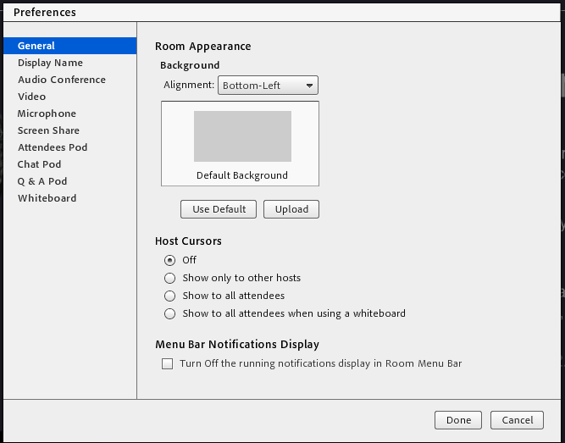
Background
Something as simple as changing the background from a plain grey to an interesting image can make a big difference to the atmosphere and identity of your ‘room’.
All you have to do is go into Meeting, then Preferences, and upload an image from your computer.

Slide 3
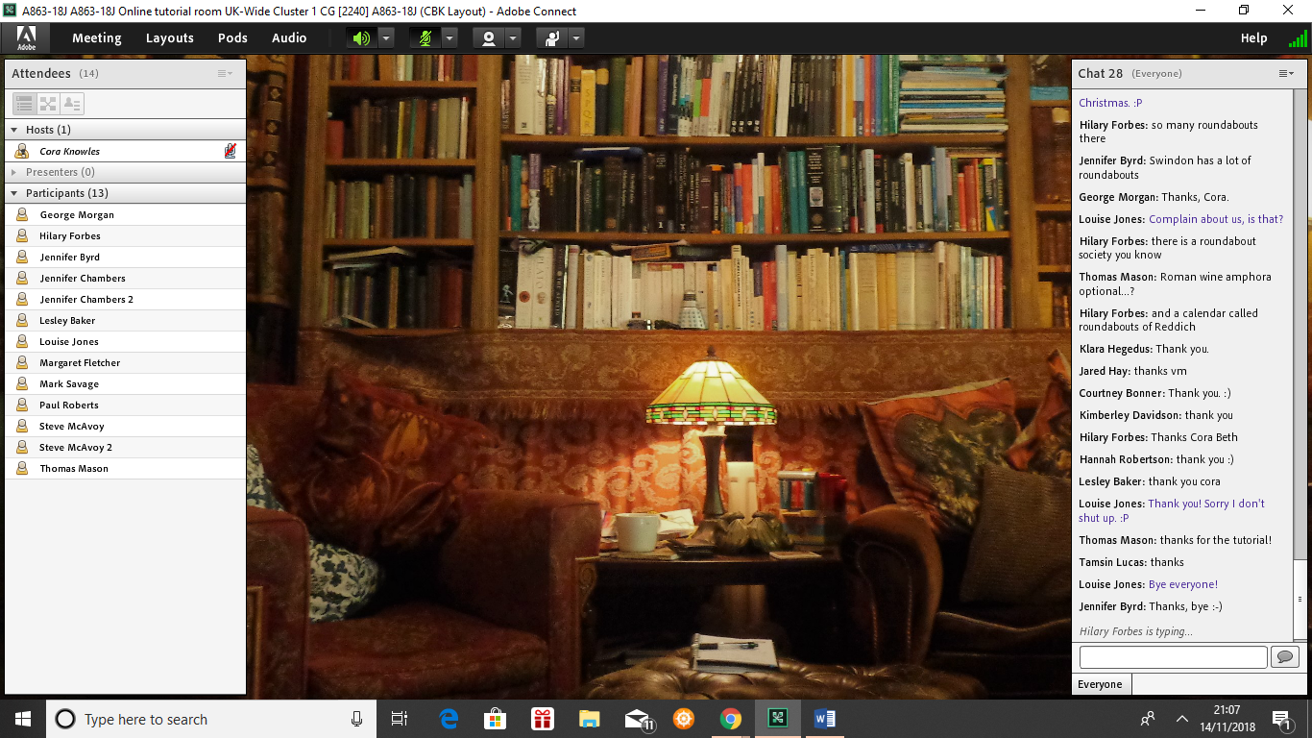
Background: an example

Slide 4
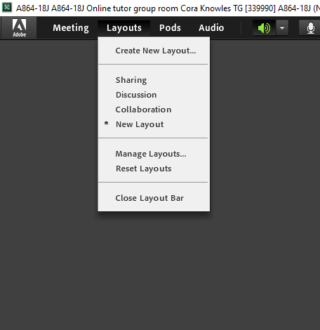
Layouts
Consider adjusting the layout: you can make your own ‘new layout’, or you can just move and resize the boxes on the normal layout.
Changing the size of pods can encourage a particular type of communication: so, for example, a big ‘Video’ pod with a grid layout can encourage attendees to switch on their webcams.

Slide 5
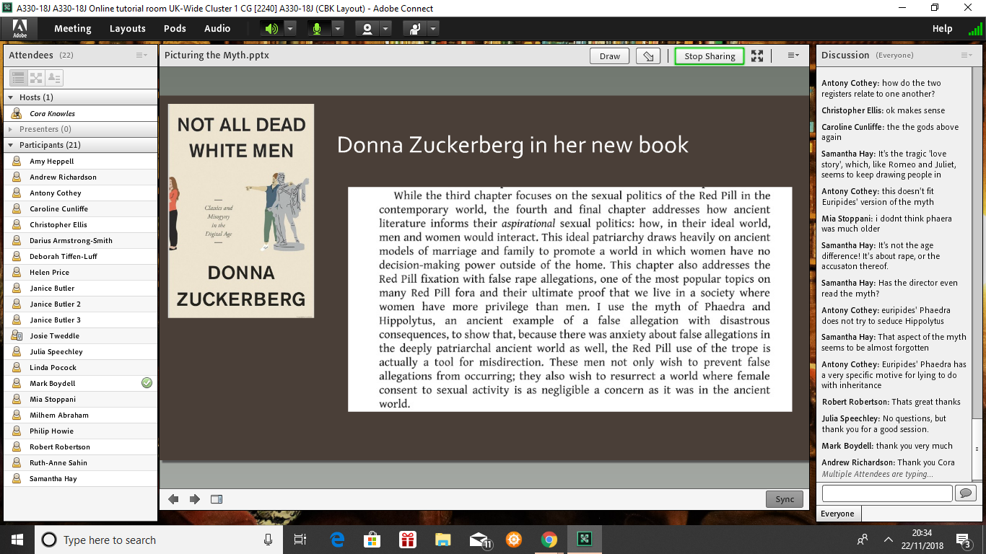
Layouts: an example

Slide 6
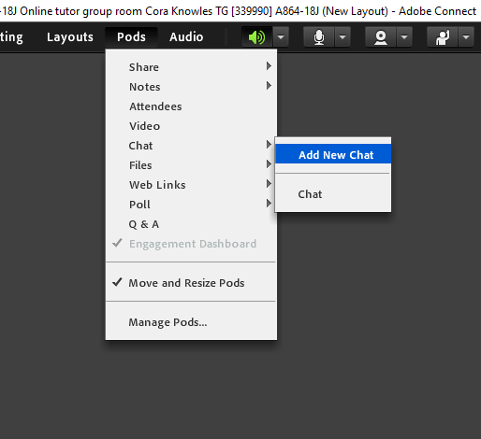
Chat boxes
Chat boxes are flexible and easy to create on the fly.
A big chat box makes it easier to keep discussions going.
You can add a new chat box for a new question, or you can have several chat boxes on the go at once, if you want to do group work without using breakout rooms.
If you’re happy to let students use text chat, this is a way of making the conversation focused and purposeful.

Slide 7
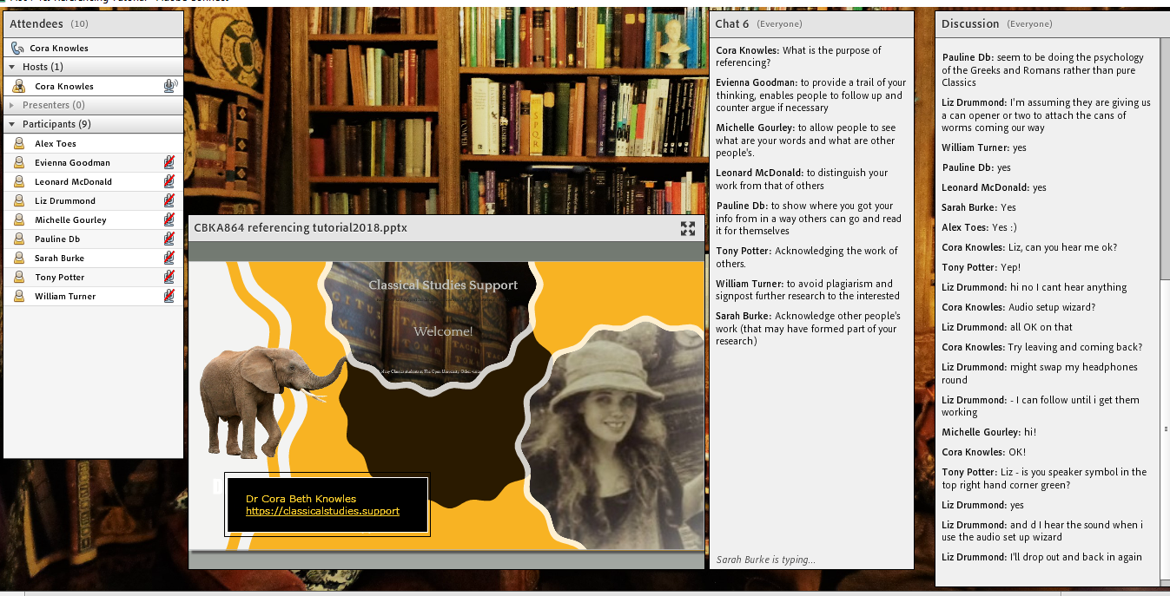
Chat boxes: an example

Slide 8
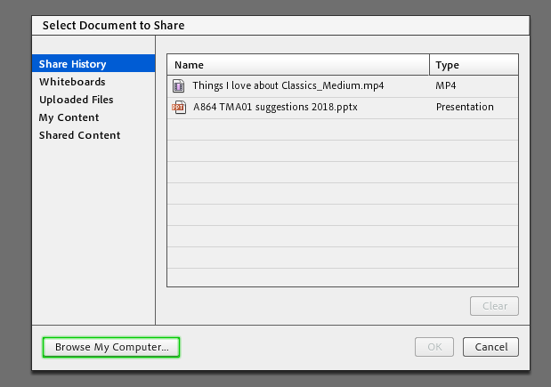
Video and other media
You don’t have to limit your sharing to documents: you can also play videos or music for your students.
You can simply upload the clip as you would a document, into the Share pod: then just click Play.
If you’re covering drama, you can show a clip of a performance or film to prompt discussion.
It gives everyone (including tutors) a brief break!

Slide 9
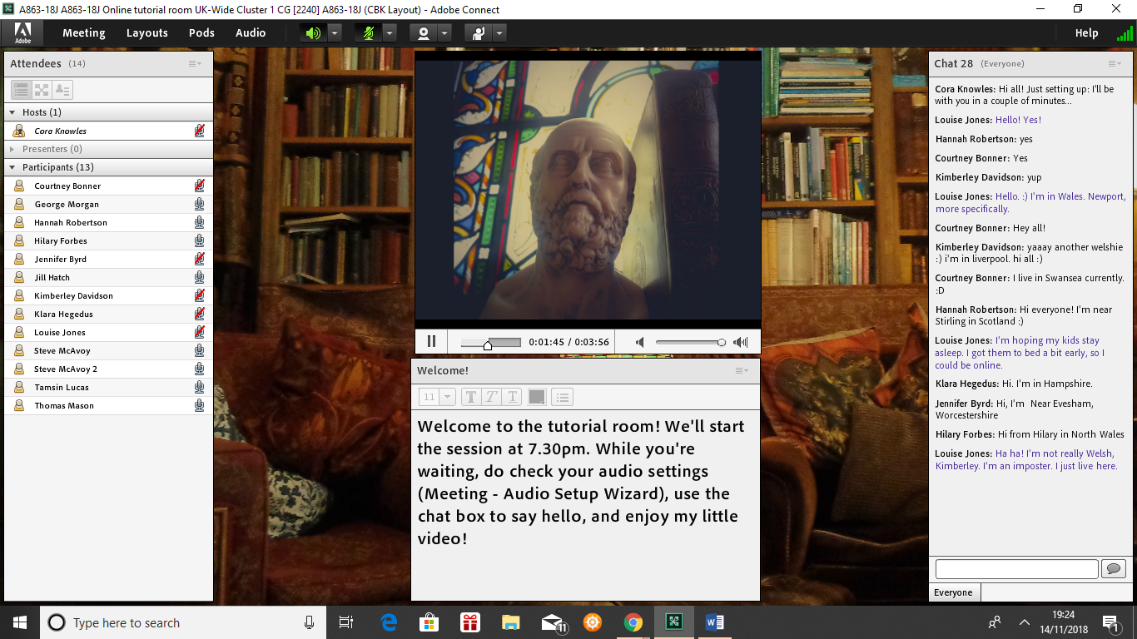
Video and other media: an example

Slide 10
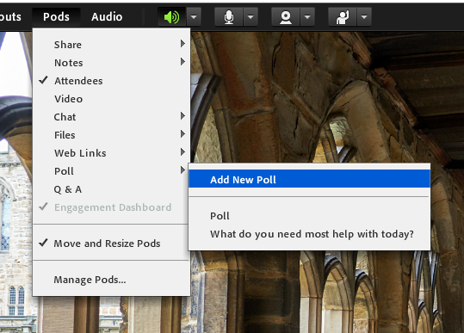
Polling
Polls are popular because they’re anonymous, so students don’t feel uncomfortable expressing an opinion.
They’re also easy for technically-challenged students, since they just require a single click.
They’re quick to set up, and you can do them on the fly or in advance.
They’re more suited to simple questions than to in-depth discussion, so they’re more of a prompt than an activity.

Slide 11
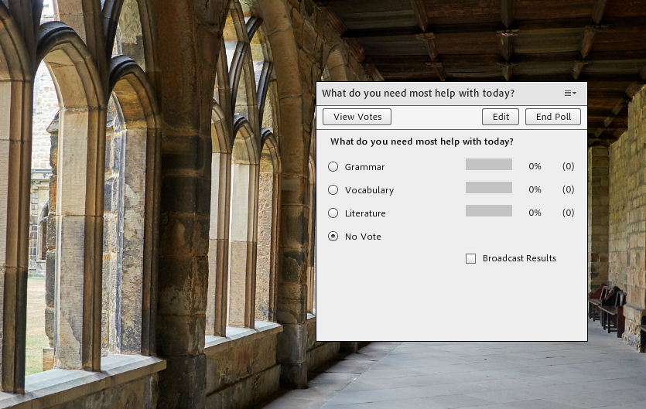
Polling

Slide 12
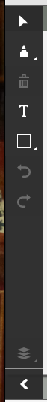
Draw
The Draw tool on the Share pod allows you to draw on your Powerpoint slides (or on shared videos).
This is particularly useful for marking up passages of text.
You can enable students to draw on the slides. This can become chaotic with a lot of students – but in a big group you can invite suggestions in the chat box and do the drawing yourself.
Draw activities work well in breakout rooms, because you can bring all the boards back to the main room for discussion and comparison.

Slide 13
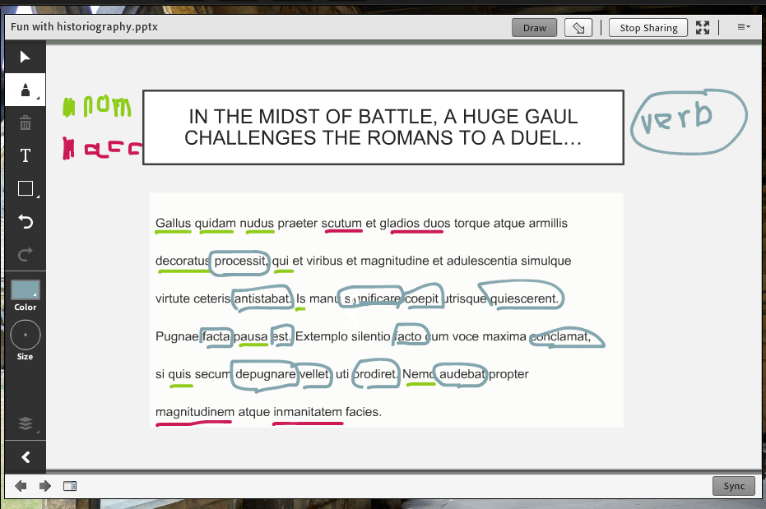
Draw: an example

Slide 14
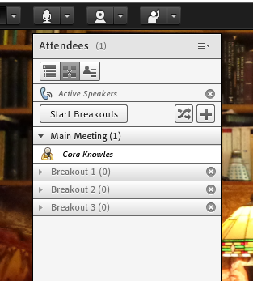
Breakout Rooms
Some people (both tutors and students) love breakout rooms: other people hate them!
Bear in mind that breakout rooms don’t record, so they’re not good for a recorded session.
Breakout rooms work best when all of the students are able and willing to use the microphone.
Careful breakout room instructions can make a big difference.

Slide 15
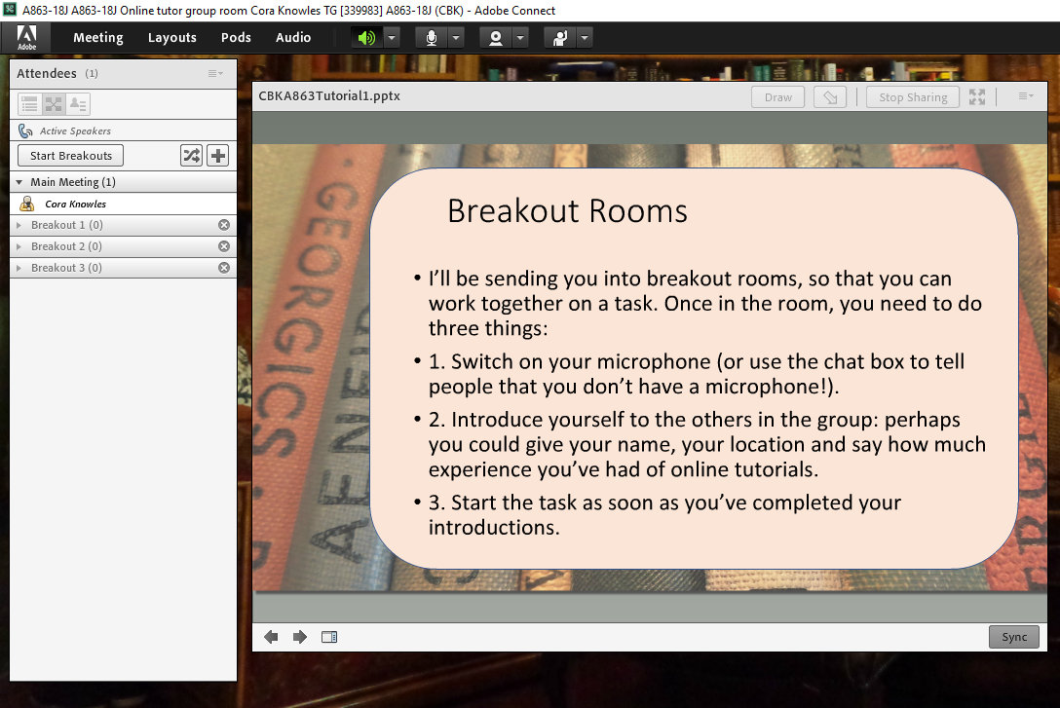
Breakout Rooms: an example

Slide 16
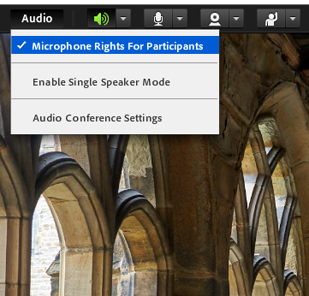
Microphones
Don’t forget to enable microphone rights if you want students to talk (under the ‘Audio’ menu).
You might want to limit microphone use to certain times, like introductions and questions at the end.
With a very big group you might choose not to enable microphones at all, and encourage students to type in the chat pod instead.

Slide 17
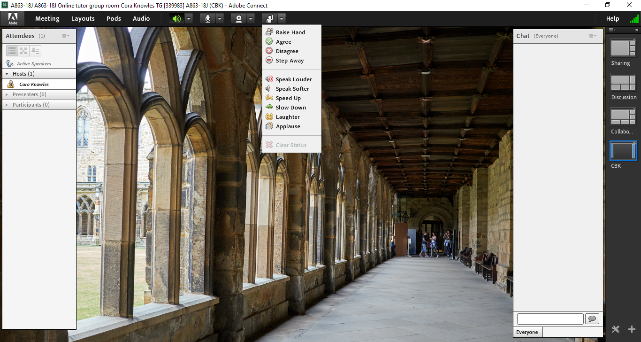
Status
The ‘Set Status’ icons are a useful way of checking to see if your audience is still awake!
Ask a ‘yes or no’ question, and instruct students to use the tick and cross to answer.
Often students struggle to locate these icons if they haven’t used them regularly: so it’s a good idea to explain where to find them, and encourage some practice in using them.
There aren’t really enough icons for these to be really useful (no ‘confused face’, for instance!).
Some of them don’t last long, so they’re easy to miss – particularly if your ‘Attendees’ pod is too small to show all the students at once.

Slide 18
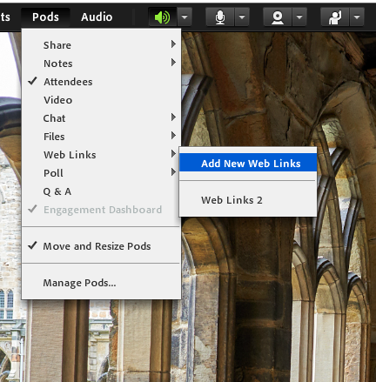
Web tours
It’s possible to show students around a website using the web links.
However, some students don’t like this, because it moves them out of the Adobe Connect layout.
Web links work best when students already have their microphones turned on, so that they can communicate with you during the tour.

Slide 19
Designing Activities in Adobe Connect

Slide 20

1.
What activity could you devise in Adobe Connect to help students who are struggling with referencing?

Slide 21
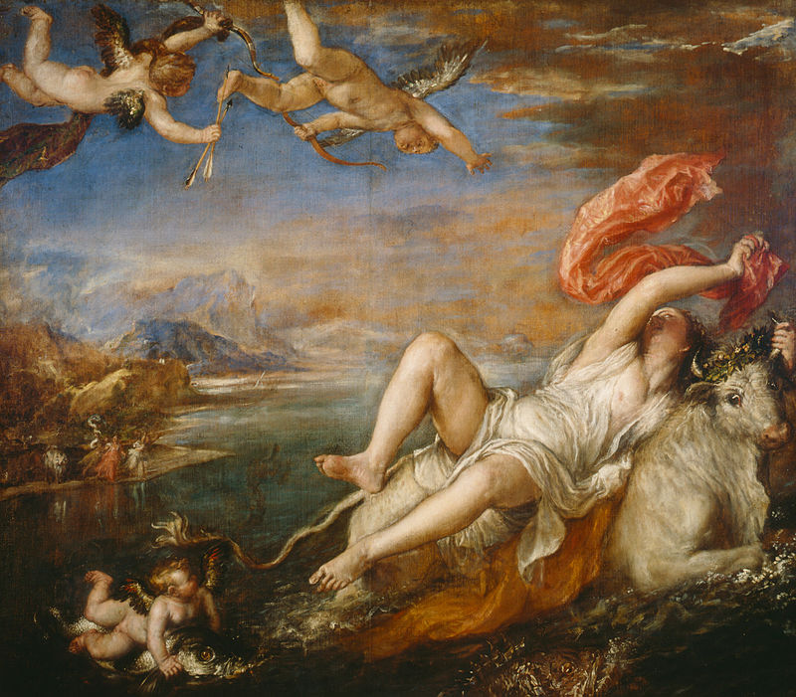
2.
A330 TMA 04 Part 1 is a compare-and-contrast exercise, using Ovid Met 2.833-75 and Titian’s Europa.
What tools would you use to help students analyse a painting?

Slide 22
3.
A276 TMA 03 essay: To what extent does Virgil’s Aeneid portray Aeneas as an embodiment of Roman virtues?
What tools would you use in Adobe Connect to prompt discussion of Roman virtues?

